Slide 1
Java Programming

Slide 2
Object-Oriented Thinking
A way of Viewing the World
Agents and Communities
Messages and Methods
Responsibilities
Classes and Instances

Slide 3
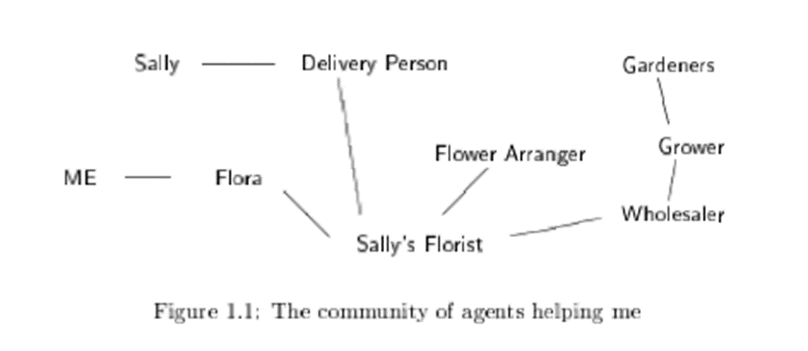
Agents and Communities

Slide 4
Agents and Communities
An object-oriented program is structured as a community of interacting agents, called objects.
Each object has a role to play.
Each object provides a service, or performs an action, that is used by other members of the community.

Slide 5
Messages & Methods
Actions are initiated in object-oriented programming by the transmission of a message to an agent (an object) responsible for the action.
The message encodes the request for an action.
It is accompanied by any additional information (arguments) needed to carry out the request.
The receiver is the object to whom the message is sent.
In response to a message, the receiver will perform some method to satisfy the request

Slide 6
Responsibilities
A fundamental concept in object-oriented programming is to describe the behavior in terms of responsibilities

Slide 7
Object
It is the basic unit of Object-Oriented Programming and it represents the real-life entities.
Examples: student, teacher, fan, dog, pen,….etc.
An object consists of:
State: It is represented by attributes of an object.
Behavior: It is represented by methods of an object.
Identity: It gives a unique name to an object.

Slide 8
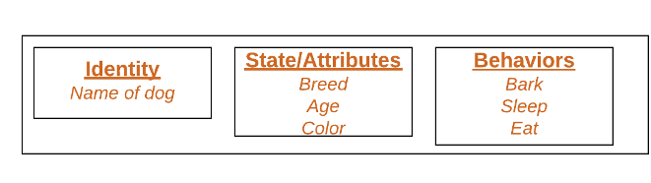
Example-Dog object

Slide 9
Class
A class is a user defined blueprint or prototype (template) from which objects are created.
It represents the set of properties or methods that are common to all objects of one type.
It has definitions of methods and data.

Slide 10
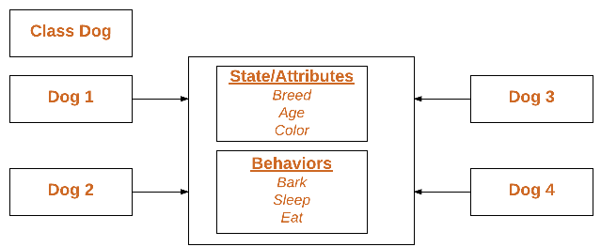
Class Example - Dog

Slide 11
Class Hierarchies-Inheritance
Classes are organized into a hierarchical inheritance structure.
A child class (or subclass) will inherit attributes from a parent class higher in the tree
An abstract parent class for which there are no direct instances, it is used only to create subclasses.

Slide 12
Binding, Overriding, and Exceptions
Determining which method will be invoked at run-time
Methods of the same name in the class hierarchy is overriding
In response to a message, the search for a method begins with the class of the receiver
If no method is found, the search is conducted in the parent class
The search continues up the parent class chain until either a method is found or the chain is exhausted
If the method is found, it will be executed
If not, an error message is issued
Notes:
*s = &ws
S->makeCall()

Slide 13
Summary of Object-Oriented Concepts
Everything is an object.
Computation is performed by objects communicating with each other by sending and receiving messages.
Each object has its own memory.
Every object is an instance of a class.
The class is the repository for behaviour associated with an object.
Classes are organized into a singly rooted tree structure, called the inheritance hierarchy .

Slide 14
An overview of Java
Java was originally developed by James Gosling at Sun Microsystems (which has since been acquired by Oracle Corporation)
1991, first version called “OAK” was released and in 1995 the name “Java” came into existence.
Oracle Corporation is the current owner of the official implementation of the Java SE platform.
The Oracle implementation is available for Microsoft Windows, Mac OS X, Linux and Solaris.
Java is reliable, portable and easy to use.

Slide 15
What is Java Programming language
Java is a general-purpose computer programming language .
It is intended to let application developers “write once, run anywhere” (WORA).
WORA is achieved by compiling a Java program into an intermediate language called bytecode.
The format of bytecode is platform-independent.
A virtual machine, called the Java Virtual Machine (JVM), is used to run the bytecode on each platform.
Different JVMs are written specifically for different host hardware and OS.

Slide 16
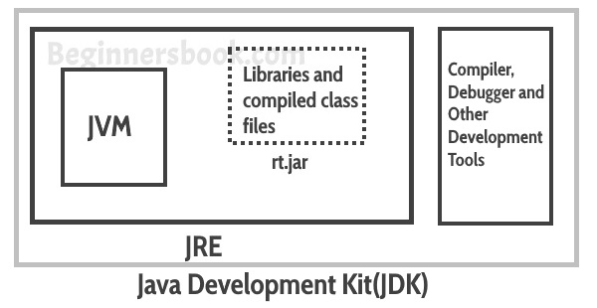

What is Java JDK, JRE and JVM?

Slide 17
What is Java JDK, JRE and JVM?
Java Virtual machine (JVM) is the virtual machine that runs the Java bytecodes.
JVM uses two inbuilt interpreter and JIT compiler to convert the bytecode to machine code and execute it.
The Java Runtime Environment (JRE) is a software package which bundles the libraries (jars) and the Java Virtual Machine to run applications written in the Java.
JDK is a superset of JRE. JDK contains everything that JRE has along with development tools for developing, debugging, and monitoring Java applications.

Slide 18
Java Installation & path setting
Java oracle: https://www.oracle.com/in/java/technologies/javase/javase-jdk8-downloads.html
YouTube link: https://www.youtube.com/watch?v=f7rT0h1Q5Wo

Slide 19
Hello world program
class Test
{
public static void main(String args[])
{
System.out.println("Hello World");
}
}
Notes:
JAVA Install

Slide 20
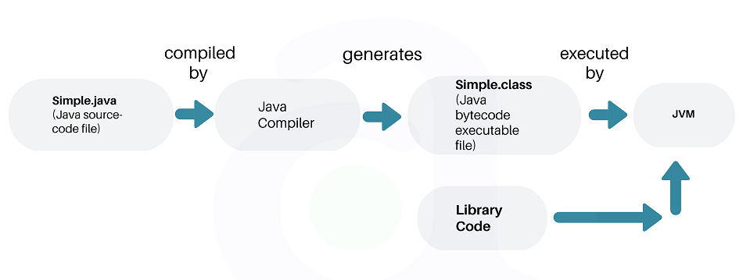
Execution of a Java Program

Slide 21
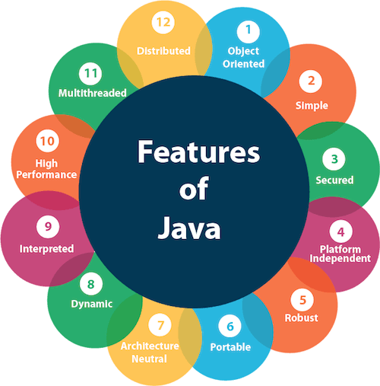
The Java Buzzwords
Java Is Object-Oriented
Java Is Simple
Java Is Secure
Java Is Platform Independent
Java Is Robust
Java Is Portable
Java Is Architecture-Neutral
Java Is Dynamic
Java Is Interpreted and High performance
Java Is Multithreaded
Java Is Distributed

Slide 22
Java Buzzwords (cont.)
Object-oriented: Java is designed around the concept of objects, which encapsulate data and behavior. It supports principles such as Abstraction, Encapsulation, Inheritance and Polymorphism.
Simple: Java is designed to be easy to learn and use, with syntax similar to C++. It avoids complex features present in other languages like pointers and operator overloading.

Slide 23
Java Buzzwords (cont.)
Secure: Java's robust security features include a bytecode verifier to ensure code integrity, runtime security checks, and a security manager to control access to system resources.
Robust: Java emphasizes reliability through features like strong memory management, exception handling, and type checking.

Slide 24
Java Buzzwords (cont.)
Portable: Java's "Write Once, Run Anywhere" (WORA) philosophy enables developers to write code once and deploy it across multiple platforms without modification.
Platform-independent: Java programs can run on any device or platform that supports Java Virtual Machine (JVM), making it highly portable.
Architecture-neutral: Java is architecture neutral because there are no implementation dependent features, for example, the size of primitive types is fixed.

Slide 25
Java Buzzwords (cont.)
Interpreted: Java source code is initially compiled into bytecode, which is a platform-independent intermediate representation. This bytecode is then interpreted by the Java Virtual Machine (JVM) at runtime. This interpretation allows Java programs to be executed on any system with a compatible JVM without the need for recompilation.
High performance: While Java's performance was initially a concern, advancements in JVM technology and just-in-time (JIT) compilation have significantly improved its execution speed.

Slide 26
Java Buzzwords (cont.)
Dynamic: Java supports dynamic loading of classes, which enables applications to dynamically extend their functionality.
Distributed: Java is designed to make distributed computing easy with Technologies like RMI(Remote Method Invocation) and EJB(Enterprise Java Bean).
Multithreaded: Java provides built-in support for multithreading, allowing concurrent execution of multiple threads within a single program.

Slide 27
Java 1.5 (5.0)’s Scanner class
Prior to Java 1.5 getting input from the console involved multiple steps.
Java 1.5 introduced the Scanner class which simplifies console input. It can also be used to read from files and Strings (among other sources).
Scanner is in the java.util package. So you must: import java.util.Scanner;

Slide 28
Scanner class
Scanner class is used for obtaining the input of the primitive types like int,double,strings, etc.
To create an object of Scanner class, we usually pass the predefined object System.in, which represents the Standard input stream.
We may pass an object of class File if we want to read input from a file

Slide 29
Creating Scanner objects
Constructing a Scanner object to read console input:
Scanner name = new Scanner(System.in);
Example:
Scanner s = new Scanner(System.in);
**You make a new object of Scanner class and you store it in variable s.
**At the same time you are calling the constructor of the class, with the parameter System.in

Slide 30
Scanner class methods
Method | Description
nextBoolean() | Reads a boolean value from the user
nextByte() | Reads a byte value from the user
nextDouble() | Reads a double value from the user
nextFloat() | Reads a float value from the user
nextInt() | Reads a int value from the user
nextLine() | Reads a String value from the user
nextLong() | Reads a long value from the user
nextShort() | Reads a short value from the user

Slide 31
Example
import java.util.Scanner;
class Example
{
public static void main(String args[])
{
Scanner s = new Scanner(System.in);
System.out.println(“Enter your name:”);
String name = s.nextLine();
System.out.println(“Name = “+name);
}
}

Slide 32
REAL WORLD ENTITIES
Object oriented concepts will model the real world entities into a Java program
Entities that exist in real world like
Man made objects
Purchase order
Materials
Human beings
Plants, animals
Computer object, etc.

Slide 33
Every real world entity has 2 qualities
State → Data
Behavior →What it does
Example:
Account
State
Account number
Account Holder
Account Balance
Account Bank Name
Account Branch Name, etc
Behavior
Withdraw amount
Deposit amount
Update passbook
Transfer amount
Transfer Account

Slide 34
How to create real world entity in Java?
Class Account
{
State
-
-
Behavior
-
-
}

Slide 35
How to create object?
Account a;
a is used to point an object but still not pointing
a = new Account();
new is an operator
a is a pointer reference to object(memory)
Account is the object
Account a = new Account();

Slide 36
Calling methods using objects
Account a = new Account();
Account a1;
a1=new Account();
a.withdraw();
a1.deposit();

Slide 37
Command line arguments
Arguments which are given along with commands.
A command-line argument is the information that directly follows the program's name on the command line when it is executed.
They are stored as strings in a String array passed to the args parameter of main( ).
So, accessing the command-line arguments inside a Java program is quite easy.

Slide 38
Command line arguments
The command line arguments are given in the following format
C:\> java Test 1 2 3
Test is command
1 2 3 are command line arguments
The number of arguments can be calculated using the function length
E.g. args.length
To print arguments we can use a for loop
E.g. for(int i=0;i<args.length;i++)
System.out.println(args[i]);

Slide 39
Command Line arguments
Initializing the state of a class using command line arguments.
E.g. a.ano=args[0];
a.aholder=args[1];, etc.
Type casting in Java.
To convert integer to string
Integer.parseInt(args);
Integer is a class
parseint will convert String to Integer.

Slide 40
Data types
There are 2 types of languages:
First, Statically typed language, where each variable and expression type is already known at compile time. Once the variable is declared to be of a certain data type, it cannot hold values of other data types. E.g. C,C++,Java
The other is Dynamically typed languages. These languages can receive different data types over time. E.g. Ruby, Python

Slide 41
Data types
Java is statically typed and also a strongly typed language.
Java is strongly typed language because every variable must be declared with a data type.
A variable cannot start off life without knowing the range of values it can hold, and once it is declared, the data type of the variable cannot change.

Slide 42
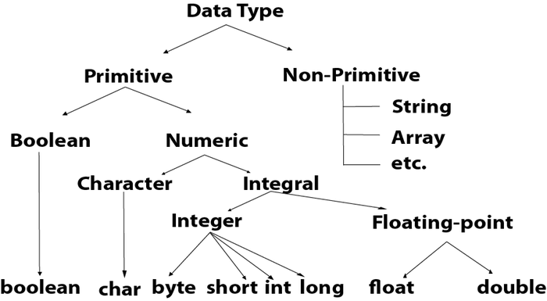
Data type

Slide 43
Data types
There are 8 types of primitive data types: (the size of primitive data types does not change from one operating system to another)
boolean
char
byte
short
int
long
float
double

Slide 44
Data types
byte, short, int and long data types are used for storing whole numbers.
float and double are used for fractional numbers.
char is used for storing characters(letters)
boolean data type is used for variables that holds either true or false.

Slide 45
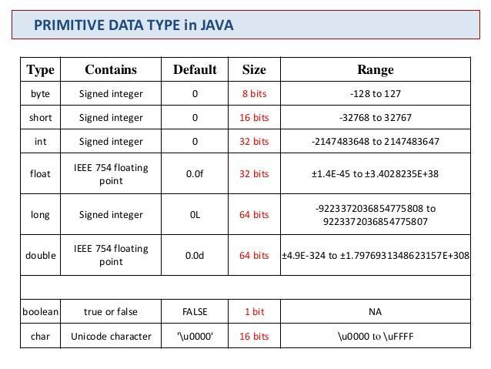

Slide 46
Declarations
Boolean Data type
boolean a = false;
Byte Data type
byte a = 10;
byte b=-20;
Short Data type
short s = 10000;
short r = -5000;
Int Data type
int a = 100000;
int b = -200000;

Slide 47
Declarations
Long Data type
long a = 100000L;
long b = -200000L;
Double Data type
double d = 12.3;
double d = 12E4d;
Float Data type
float f = 234.5f;
float f = 35e3f;
Char Data type
char a = ‘A’;
A floating point can also be a scientific number with an ‘e’ to indicate the power of 10.
Character uses 2 bytes because Java uses Unicode system than ASCII code system. The lowest range of Unicode system is \u0000

Slide 48
Non – Primitive Data types
Non – primitive data types are called reference types because they refer to objects.
E.g. Strings, Arrays, objects, Interfaces, etc.

Slide 49
Difference between Primitive and Non – primitive data types
Primitive Data types | Non – Primitive Data types
They are predefined in Java | They are created by the programmer, not defined by Java (except Strings)
They cannot call methods | They can call methods to perform certain operations
It always has a value | These can be null
It starts with a lowercase letter | It starts with a uppercase letter
Size depends on the data type | All have same size

Slide 50
Java Type casting
Type casting is when you assign a value of one primitive data type to another type.
In Java we have 2 types of casting:
Widening casting (automatically)
Converting a smaller data type to larger type size
Narrowing casting (manually)
Converting a larger type to a smaller size type

Slide 51
Widening
Done automatically when passing a smaller size type to a larger size type.
public class M
{
public static void main(String args[])
{
int i = 9;
double d = i ;
System.out.println(i);
System.out.println(d);
}
}

Slide 52
Narrowing
Must be done manually by placing the type in parenthesis in front of the value
public class M
{
public static void main(String args[])
{
double d = 9.78;
int i = (int)d;
System.out.println(d);
System.out.println(i);
}
}

Slide 53
Variables
The variable is the basic unit of storage in a Java program.
The basic form of a variable declaration:
type identifier [ = value][, identifier [= value] ...];
The type is one of Java‘s atomic types, or the name of a class or interface.
The identifier is the name of the variable.

Slide 54
Operators
Java provides many types of operators that are used to perform operations on variables and values
Types of operators:
Basic Arithmetic operators
Assignment operators
Auto – increment and Auto – decrement operator
Logical operators
Comparison (relational) operators
Bitwise operators
Ternary operator

Slide 55
Basic Arithmetic operators
Basic arithmetic operators are: +, -, *, /, % + is for addition.
– is for subtraction.
* is for multiplication.
/ is for division.
% is for modulo. Note: Modulo operator returns remainder, for example 10 % 5 would return 0

Slide 56
Assignment operators
Assignments operators in java are: =, +=, -=, *=, /=, %= a = b would assign value of variable b to the variable a.
a+=b is equal to a = a+b
a-=b is equal to a = a-b
a*=b is equal to a = a*b
a/=b is equal to a = a/b
a%=b is equal to a = a%b

Slide 57
Auto increment & Auto decrement operators
++ and - - a++ is equivalent to a=a+1;
a- - is equivalent to a=a-1;

Slide 58
Logical operators
Logical Operators are used with binary variables.
They are mainly used in conditional statements and loops for evaluating a condition.
Logical operators in java are: &&, ||, !
Let’s say we have two boolean variables x and y.
x&&y will return true if both x and y are true else it would return false.
x||y will return false if both x and y are false else it would return true.
!x would return the opposite of x, that means it would be true if x is false and it would return false if x is true.

Slide 59
Comparison (Relational) operators
We have six relational operators in Java: ==, !=, >, <, >=, <=
== returns true if both the left side and right side are equal
!= returns true if left side is not equal to the right side of operator.
> returns true if left side is greater than right.
< returns true if left side is less than right side.
>= returns true if left side is greater than or equal to right side.
<= returns true if left side is less than or equal to right side.

Slide 60
Bitwise operators
There are six bitwise Operators: &, |, ^, ~, <<, >>
x = 11; /* equal to 00001011*/ y = 22; /* equal to 00010110 */
Bitwise operator performs bit by bit processing. x & y compares corresponding bits of x and y and generates 1 if both bits are equal, else it returns 0. In our case it would return: 2 which is 00000010 because in the binary form of x and y only second last bits are matching.
x | y compares corresponding bits of x and y and generates 1 if either bit is 1, else it returns 0. In our case it would return 31 which is 00011111
x ^ y compares corresponding bits of x and y and generates 1 if they are not equal, else it returns 0. In our example it would return 29 which is equivalent to 00011101

Slide 61
Bitwise operators
~x is a complement operator that just changes the bit from 0 to 1 and 1 to 0. In our example it would return -12 which is signed 8 bit equivalent to 11110100
x << 2 is left shift operator that moves the bits to the left, discards the far left bit, and assigns the rightmost bit a value of 0. In our case output is 44 which is equivalent to 00101100
Note: In the example below we are providing 2 at the right side of this shift operator that is the reason bits are moving two places to the left side. We can change this number and bits would be moved by the number of bits specified on the right side of the operator. Same applies to the right side operator.
x >> 2 is right shift operator that moves the bits to the right, discards the far right bit, and assigns the leftmost bit a value of 0. In our case output is 2 which is equivalent to 00000010

Slide 62
Ternary operator
This operator evaluates a boolean expression and assign the value based on the result. Syntax:
variable h = (expression) ? value if true : value if false
If the expression results true then the first value before the colon (:) is assigned to the variable h else the second value is assigned to the h.

Slide 63
Operator precedence in Java
This determines which operator needs to be evaluated first if an expression has more than one operator. Operator with higher precedence at the top and lower precedence at the bottom. Unary Operators ++ – – ! ~
Multiplicative * / %
Additive + –
Shift << >> >>>
Relational > >= < <=
Equality == !=
Bitwise AND &
Bitwise XOR ^
Bitwise OR |
Logical AND &&
Logical OR ||
Ternary ?:
Assignment = += -= *= /= %= > >= < <= &= ^= |=

Slide 64
Arrays
An array is a collection of similar type of elements which have a continuous memory
We can dynamically allocate memory to arrays using new operator
Declaring and initializing array
Printing array
For each loop
Passing array as parameter to static method
Reading and printing array elements using Scanner class

Slide 65
Inheritance

Slide 66
Introduction
In Java it is possible to inherit attributes and methods from one class to another
Inheritance
Subclass (Child): The class that inherits from another
Superclass(Parent): The class being inherited from
To inherit from a class, use the extends keyword.

Slide 67
Introduction
Why use Inheritance in Java?
For method overriding
For code reusability
Terms in Inheritance
Class
Subclass/Child class
Super class/Parent class
Reusability

Slide 68
Introduction
Syntax
Class subclass_name extends superclass_name
{
//methods and fields
}
/*The extends keyword indicates that you are making a new class that derives from an existing class. The meaning of “extends” is to increase the functionality*/

Slide 69
Introduction
Types of Inheritance
Single
Multilevel
Class A
Class B
Class A
Class B
Class C

Slide 70
Introduction
Types of Inheritance
Hierarchical
Multiple
Java does not support Multiple Inheritance to avoid ambiguity
Class A
Class B
Class C
Class A
Class B
Class C

Slide 71
Constructors and Inheritance
Default constructor of parent class can be called directly at the time of object creation of child class
But, to call a parameterized constructor we need to use the super keyword
Note:
The base class constructor call must be the first line in derived class constructor

Slide 72
Polymorphism

Slide 73
Introduction
‘Poly’ means many, ‘morphs’ means forms
Polymorphism means many forms
It is concept by which one can perform a single action in different ways.
Polymorphism
Ad-Hoc
Or
Compile time (Static)
Or
Method overloading
Pure
Or
Dynamic method dispatch (runtime)
Or
Method overridding

Slide 74
Introduction
Overloading Overridding
Base
Test
void fun(int a)
void fun(int a)
void fun(int a,int b)
void fun(char a)
Derived
void fun(int a)

Slide 75
Ad-Hoc Polymorphism
Method overloading is an example of Ad-hoc or compile time polymorphism.
class Overload
{
void demo()
{
}
void demo(int a)
{
}
void demo(int a,int b)
{
}
public static void main(String args[])
{
Overload p=new Overload();
p.demo();
p.demo(10);
p.demo(10,20);
} }
In this example, demo() method is overloaded 3 times, which method is to be called is determined by the arguments we pass while calling methods, this happens in compile time so it is known as compile time polymorphism

Slide 76
Pure Polymorphism
Method overriding is an example of pure or run time polymorphism.
class A
{
void demo()
{
}
}
class B extends A
{
void demo()
{
}
}
class Overridde
{
public static void main(String args[])
{
A a=new b();
a.demo();
}
}
In this example, demo() method of parent class A is override by child class B. We can access the method in either A or B at the time of object creation using parent class reference and this is done at run time

Slide 77
Rules for overriding
Both the superclass and the subclass must have the same method name, the same return type and the same parameter list.
There must be an IS-A relationship (inheritance).
We cannot override the method declared as final and static.
We should always override abstract methods of the superclass
Overriding and Access-Modifiers : The access modifier for an overriding method can allow more, but not less, access than the overridden method. For example, a protected instance method in the super-class can be made public, but not private, in the subclass. Doing so, will generate compile-time error.
Private methods can not be overridden : Private methods cannot be overridden as they are bonded during compile time. Therefore we can’t even override private methods in a subclass

Slide 78
Rules for overriding
Using @Override annotation while overriding a method is considered as a best practice for coding in java because of the following two advantages:
1) If programmer makes any mistake such as wrong method name, wrong parameter types while overriding, you would get a compile time error.
2) It improves the readability of the code. So if you change the signature of overridden method then all the sub classes that overrides the particular method would throw a compilation error, which would eventually help you to change the signature in the sub classes. If you have lots of classes in your application then this annotation would really help you to identify the classes that require changes when you change the signature of a method.

Slide 79
Rules for overriding
class ParentClass
{
public void displayMethod(String msg)
{
System.out.println(msg);
}
}
class SubClass extends ParentClass
{
@Override
public void displayMethod(String msg)
{
System.out.println("Message is: "+ msg);
}
public static void main(String args[])
{
SubClass obj = new SubClass();
obj.displayMethod("Hey!!");
}
}

Slide 80
Abstract class

Slide 81
Abstraction in Java
Abstraction is a process of hiding the implementation details and showing only functionality to the user.
It shows only essential things to the user and hides the internal details, for example, you insert the key to open a door, but you do not know the process inside (i.e. how the door is getting opened)

Slide 82
Abstraction in Java
Abstraction lets you focus on what the object does instead of how it does it.
Ways to achieve Abstraction:
There are two ways to achieve abstraction in java
Abstract class
Interface

Slide 83
Abstract class in Java
A class which is declared as abstract is known as an abstract class. It can have abstract and non-abstract methods. It needs to be extended and its method implemented. It cannot be instantiated.
Points to Remember
An abstract class must be declared with an abstract keyword.
It can have abstract and non-abstract methods.
It cannot be instantiated.
It can have constructors and static methods also.

Slide 84
Abstract Method in Java
A method which is declared as abstract and does not have implementation is known as an abstract method.
Example of abstract method
abstract void Hello();//no method body and abstract
Example:
abstract class Car
{
abstract void run();
}
class Brezza extends Car
{
void run()
{
System.out.println("running safely");
}
public static void main(String args[])
{
Car obj = new Brezza();
obj.run();
}
}

Slide 85
Abstract class having constructor, data member and methods
abstract class Car
{
Car()
{
System.out.println(“Car has started");
}
abstract void run();
void changeGear()
{
System.out.println("gear changed");
}
}
//Creating a Child class which inherits Abstract class
class Brezza extends Car
{
void run()
{
System.out.println("running safely..");
}
}
//Creating a Test class which calls abstract and non-abstract methods
class TestAbstraction2
{
public static void main(String args[])
{
Car obj = new Brezza();
obj.run();
obj.changeGear();
}
}

Slide 86
Rules
If there is an abstract method in a class, that class must be abstract.
An instance of an abstract class cannot be created, we can have references of abstract class type though.
An abstract class can contain constructors in Java. And a constructor of abstract class is called when an instance of a inherited class is created.
In Java, we can have an abstract class without any abstract method. This allows us to create classes that cannot be instantiated, but can only be inherited.
If you are extending an abstract class that has an abstract method, you must either provide the implementation of the method or make this class abstract.
It can have constructors and static methods also.
Abstract classes can also have final methods (methods that cannot be overridden), which will force the subclass not to change the body of the method.

Slide 87
Inheritance continued..

Slide 88
Forms of Inheritance
Specialization:
The subclass is special case of the parent class
Example:
Person class
Employee class
Manager class ➔ Specialized class

Slide 89
Forms of Inheritance
2. Specification:
The super class just specifies which methods should be available but does not give code
Example:
Abstract classes and Interfaces

Slide 90
Forms of Inheritance
3. Construction:
The super class is just used to provide behavior, but instances of the subclass don’t really act like the super class. (Overriding)
Example:
Base Derived
M1()
M2()
M1()
M2()
Defined with new code
redefined with new code

Slide 91
Forms of Inheritance
4. Extension:
Sub class adds new methods and perhaps defines inherited ones as well
Example:
Base Derived
M1()
M2()
M1()
M2()
M3()
Defined with new code
New method

Slide 92
Forms of Inheritance
5. Limitation:
The sub class restricts the inherited behavior
Example:
Defining Queue as a subclass of Dequeue
6. Combination:
Multiple Inheritance, provided in terms of implementing multiple interfaces

Slide 93
Benefits of Inheritance
Minimizes the amount of duplicate code in an application by sharing common code amongst several subclasses
Reusability
Facility to use public methods of base class without rewriting the same
Extensibility
Extending the base class logic as per business logic of the derived class
Data binding
Base class can decide to keep some data private so that it cannot be altered by the derived class
Overriding
Override methods of the base class so that meaningful implementation can be designed in the derived class based on business logic

Slide 94
Disadvantages
Increased time/effort to jump through all the levels of overloaded classes
Example:
If a given class has 10 levels of abstraction then it has to take 10 jumps to run through a function defined in each of their classes
During maintenance adding new features will effect both base class and derived class. They both required to be changed. Example: change in method signature
In case of deleting a particular method in base class, things get a bit complicated in case of inheritance, because our programs will still compile, but methods of sub class will no longer be overriding base class methods. These methods will become like independent methods.

Slide 95
Cost of Inheritance
Execution speed
Program size
Message passing Overhead
Program complexity (in overuse of inheritance)

Slide 96
Object Class
Object class is present in java.lang package.
The Object class is the parent class of all the classes in java by default.
Every class in Java is directly or indirectly derived from the Object class.
In other words, it is the topmost class of java.
Therefore the Object class methods are available to all Java classes.
The Object class provides some common behaviors to all the objects such as
object can be compared
object can be cloned
object can be notified

Slide 97
Methods of Object class
toString()
toString() provides String representation of an Object and used to convert an object to String.
The default toString() method for class Object returns
public String toString()
{
return getClass().getName() + "@" +Integer.toHexString(hashCode());
}
hashCode() :
For every object, JVM generates a unique number which is hashcode. It returns distinct integers for distinct objects.
It convert the internal address of object to an integer by using an algorithm.
Use of hashCode() method : Returns a hash value that is used to search object in a collection which is an advantage.
JVM uses hashcode method while saving objects into hashing related data structures like HashSet, HashMap, Hashtable etc

Slide 98
equals(Object obj) :
Compares the given object to current object (the object on which the method is called).
It gives a generic way to compare objects for equality.
It is recommended to override equals(Object obj) method to get our own equality condition on Objects.
It is generally necessary to override the hashCode() method whenever this method is overridden.
getClass() :
Returns the class object of current object.
As it is final so we don’t override it.
.

Slide 99
finalize()
This method is called just before an object is garbage collected.
Garbage collector destroys the unreferenced objects.
finalize method is called just once on an object even though that object is eligible for garbage collection multiple times.
Clone()
Object cloning refers to creation of exact copy of an object.
It creates a new instance of the class of current object and initializes all its fields with exactly the contents of the corresponding fields of this object.
The remaining three methods wait(), notify() notifyAll() are related to Concurrency in threads.

